Slide 1
Billboard Hot 100
Lyrics since 1987
Notes:
Since ‘50s

Slide 2
The Billboard Hot 100 is the music industry standard record chart in the United States for singles, published weekly by Billboard magazine. Chart rankings are based on sales (physical and digital), radio play and online streaming.

Slide 3
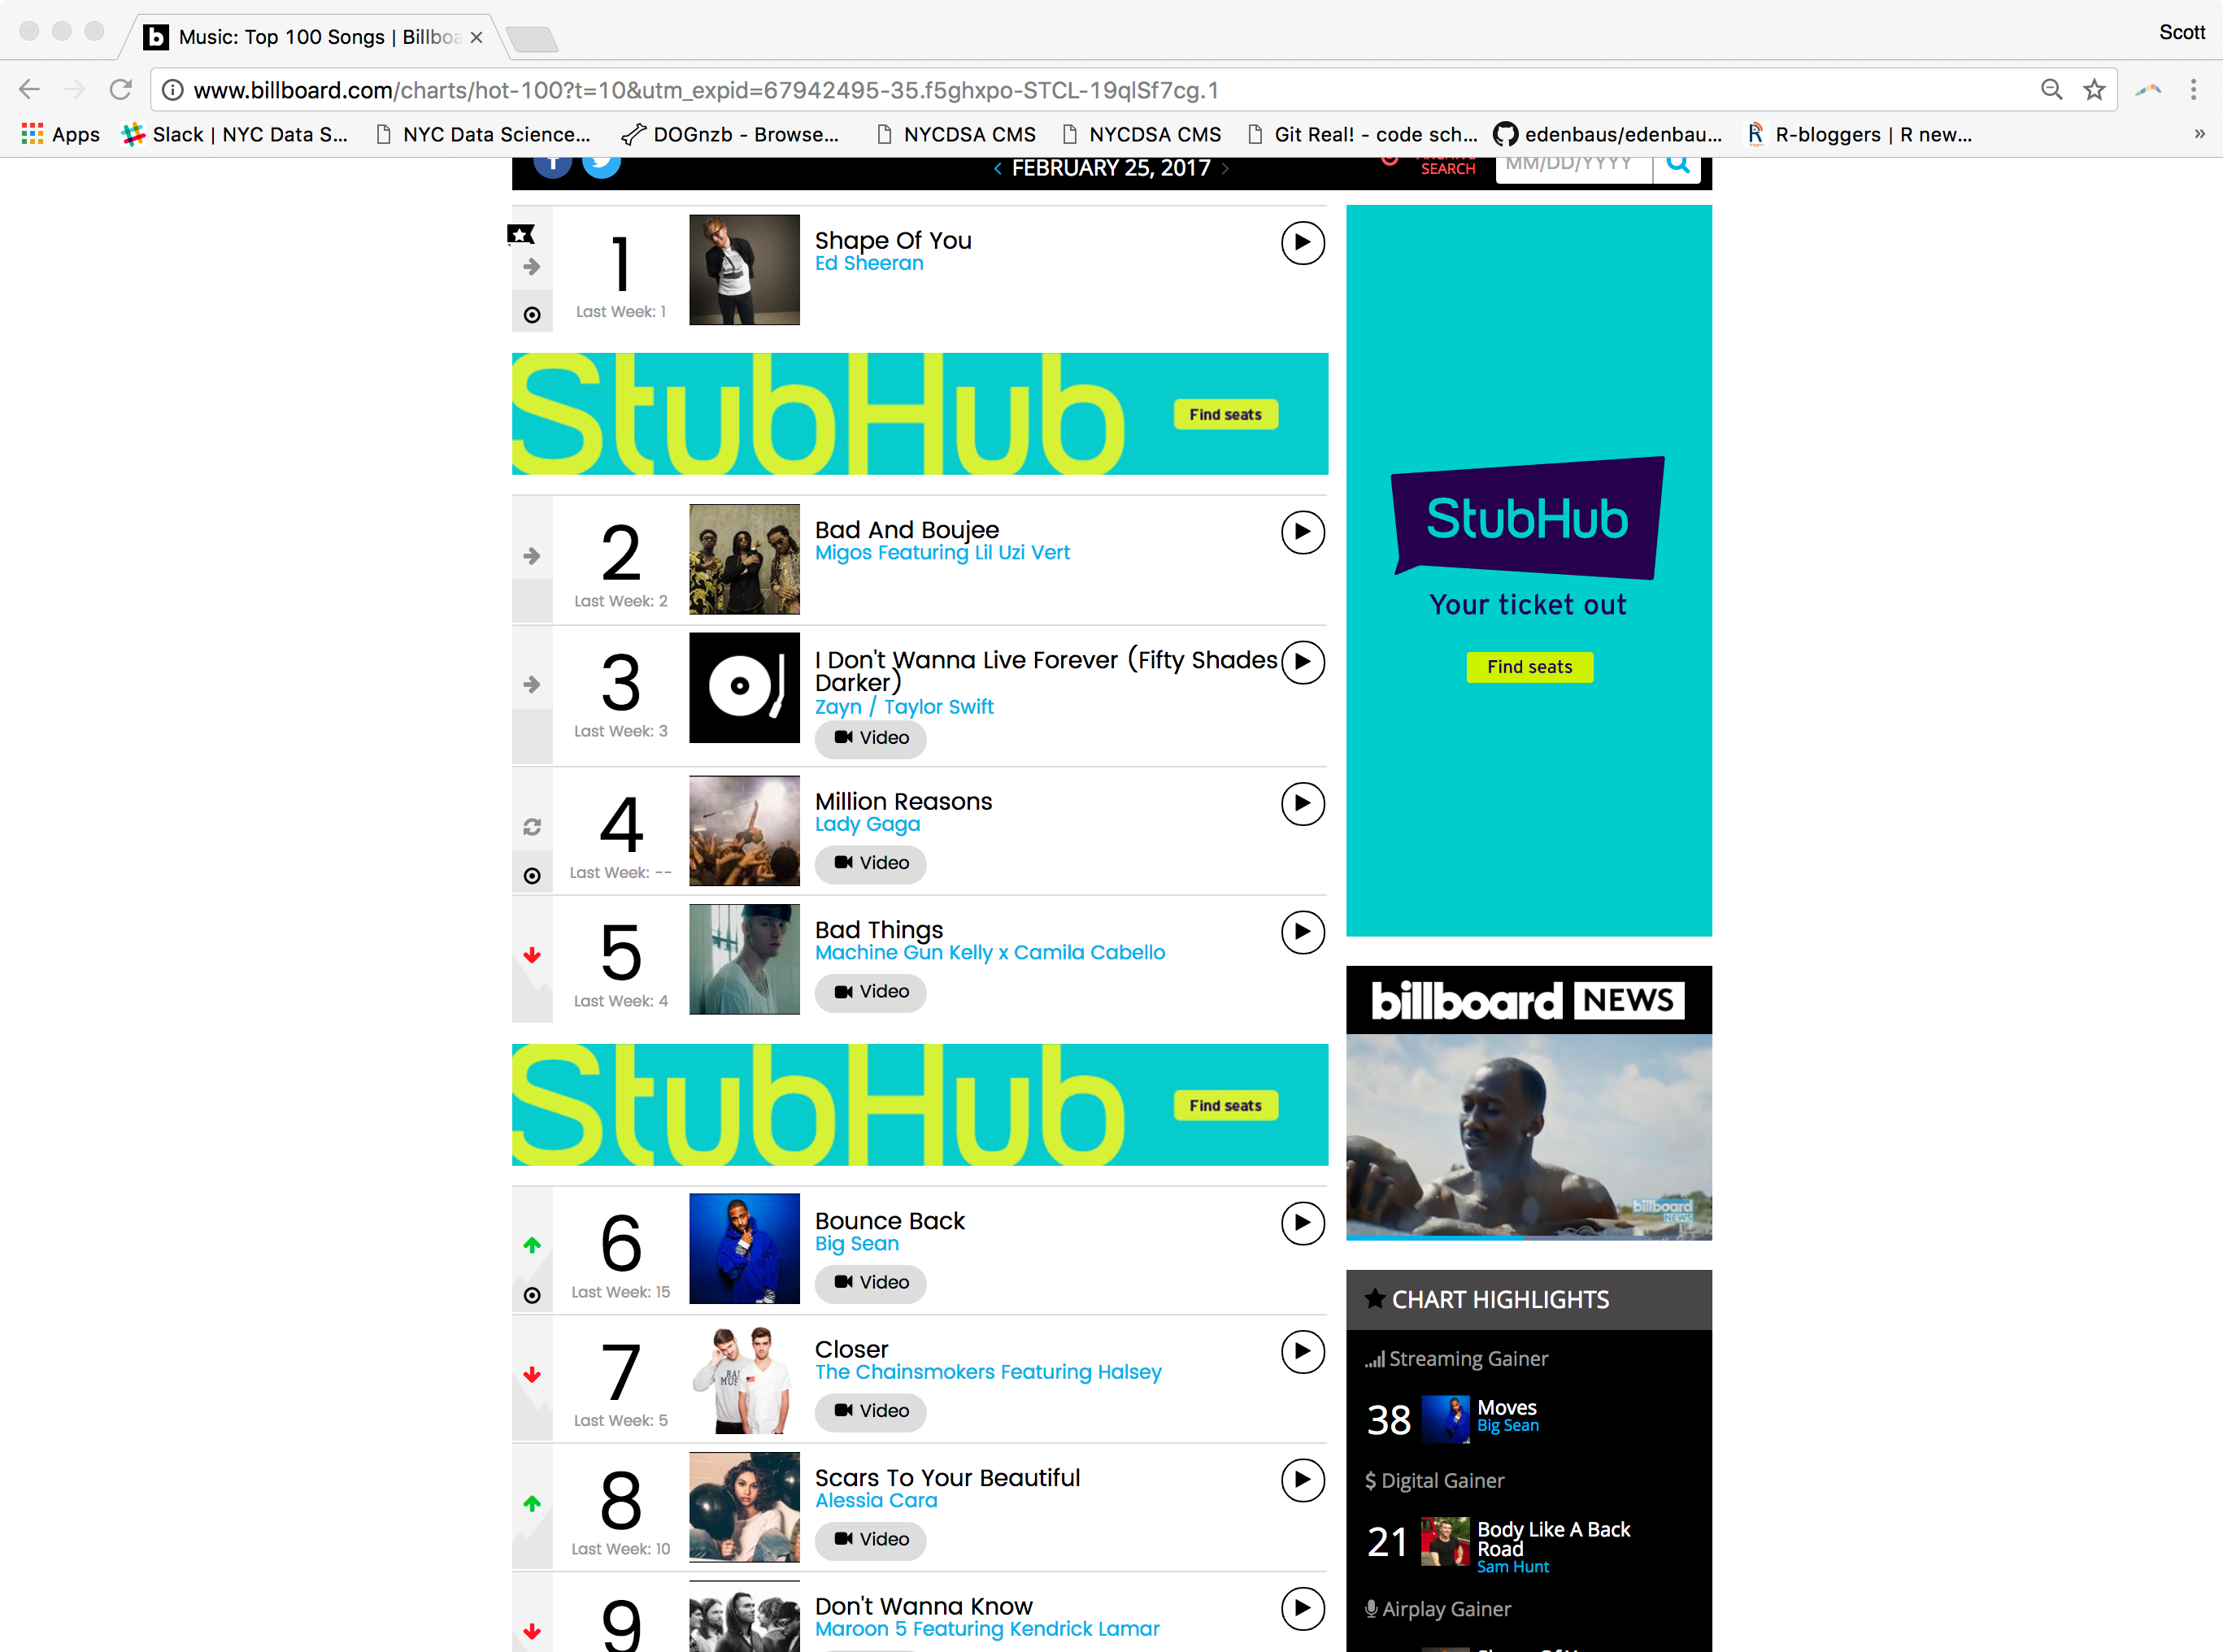
Billboard’s website

Slide 4
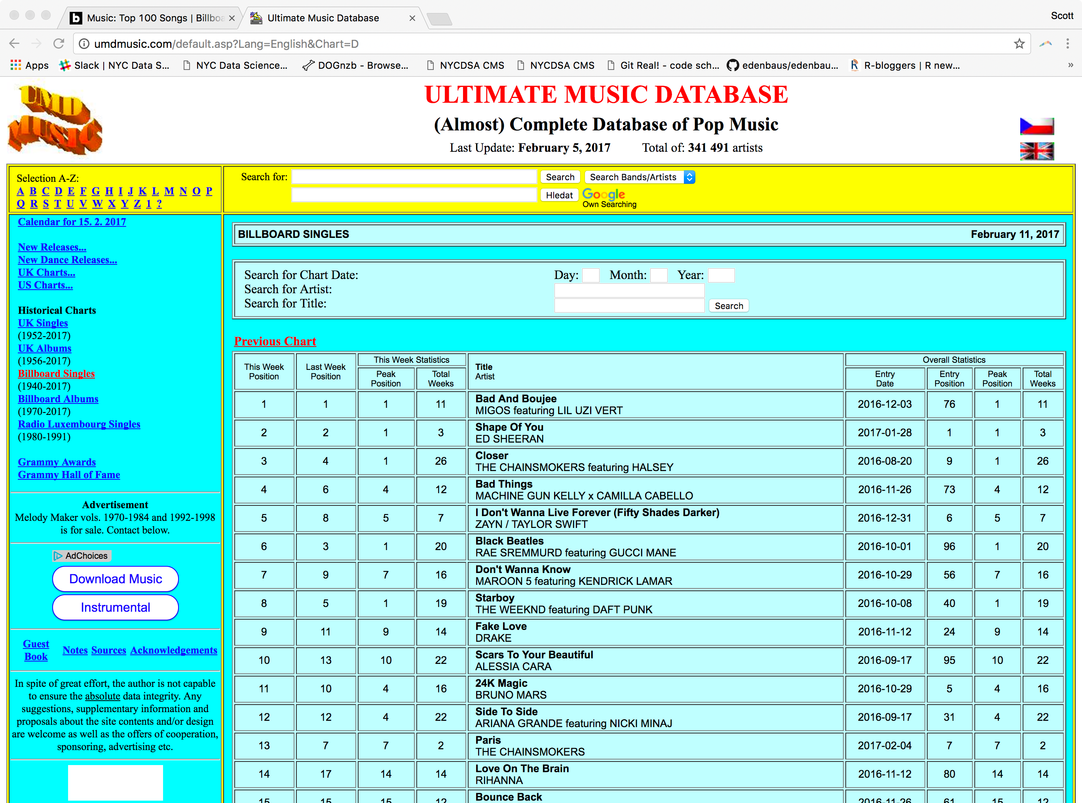
A Better option

Slide 5
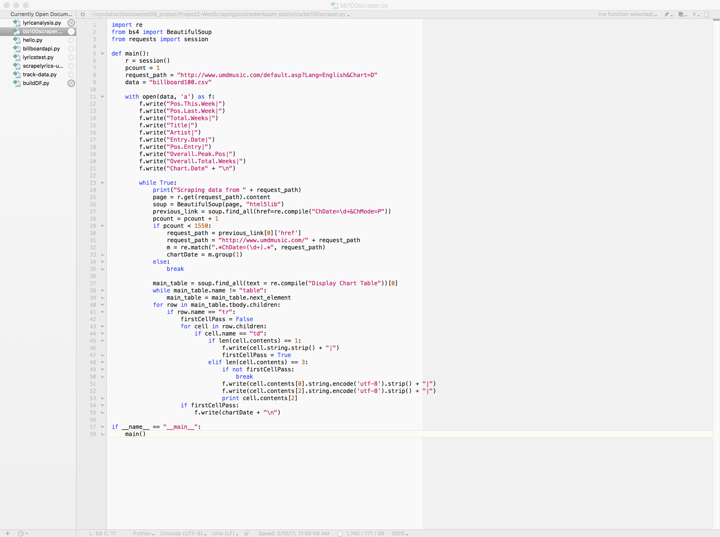
Scraping charts
Notes:
Had to pre-process, and re-do scraping to gather the artist/track/year (should have used json)

Slide 6
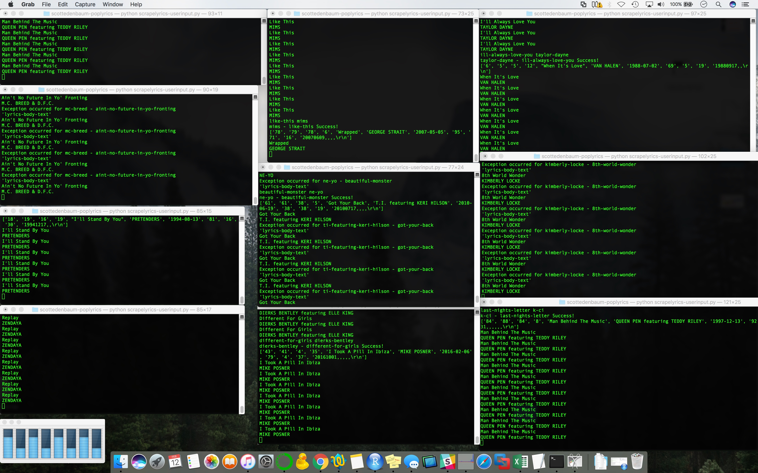
Scrape all the charts!

Slide 7
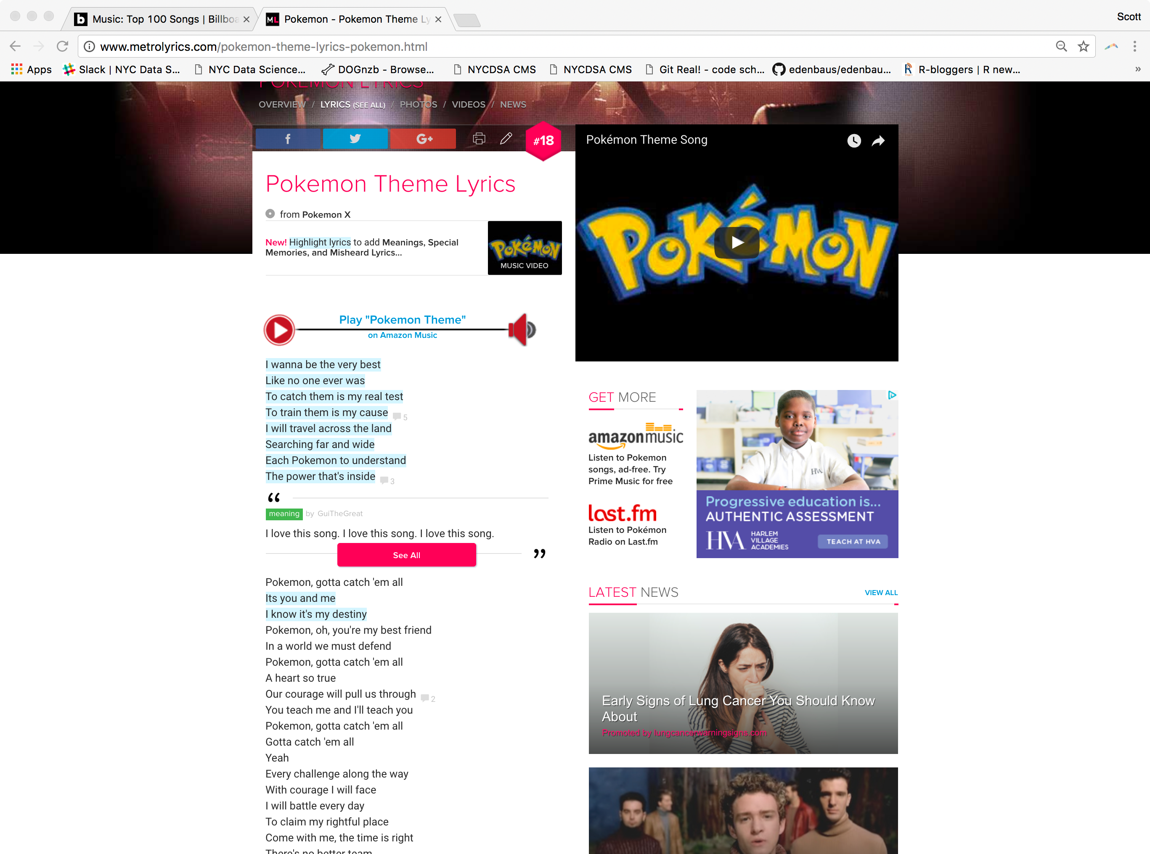
Song lyrics from metrolyrics

Slide 8
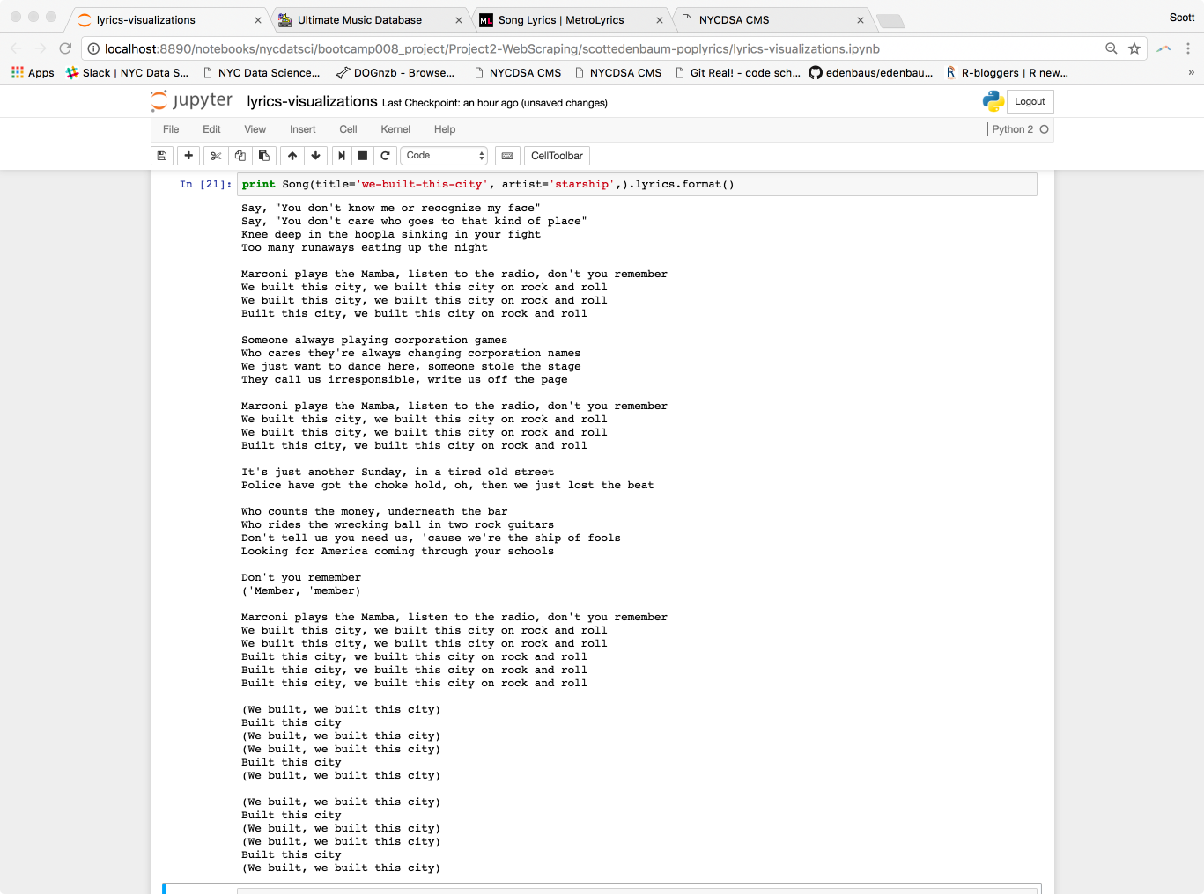
Tswift - API
Notes:
Very picky about artist/title input

Slide 9
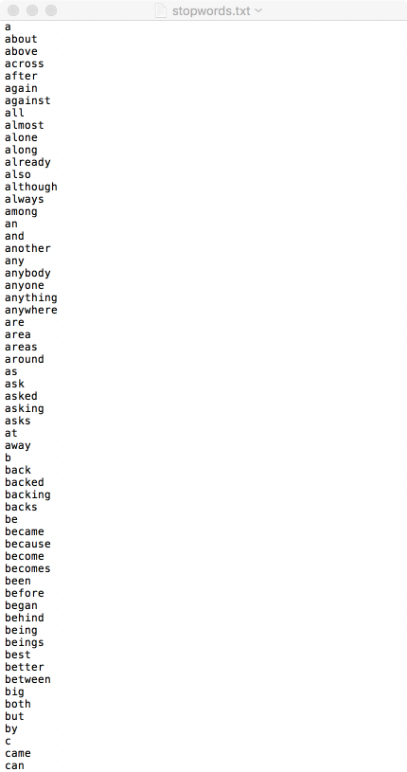
Removing stop words

Slide 10
Billboard Hot 100 Lyrics -1988

Slide 11
Wordcloud 1988

Slide 12
Billboard hot 100 lyrics 1998

Slide 13
Wordcloud 1998

Slide 14
Billboard hot 100 lyrics - 2008

Slide 15
Wordcloud - 2008

Slide 16
Billboard hot 100 lyrics - 2016

Slide 17
Wordcloud - 2016

Slide 18
Top words

Slide 19
Most frequent words
I’m
Love
Don’t
Like
Know
Oh
Just
Got
Baby
Yeah
Want
You’re
Cause
Make
Time
Let
Girl
Say
Way
Come
I’ll
Ain’t
Right
Gonna
Need

Slide 20
Notes:
Find other lyrics sources
Make scraping process more efficient
Tie in audio stats
Further semantic analysis – pos/neg/neutral

